Slide 1
Database Design And Implementation
PRESENTED BY
GROUP 22

Slide 2
Outline
Introduction
Database Design
Database Implementation
Database Security

Slide 3
1. Introduction
Effective disaster management relies on timely, accurate information for coordinating response efforts, allocating resources, and ensuring public safety.
This presentation outlines the design and implementation of a mobile-based disaster management system database, crucial for enhancing response efficiency and crisis management.

Slide 4
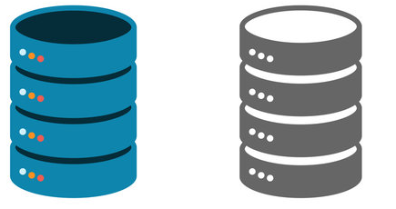
2. Database Design
Key Considerations
Performance
Scalability
Offline Functionality
Accessibility
Security
Real-time Communication

Slide 5
I. Entities and their Attributes
User
Responders
Incidents
Help_Requests
Forums
Announcements
Guides
e.g. User
ID
Name
Email:
Password
Telephone
Language
Photo
Role
Locations
Forums

Slide 6
II. Define Relationships and References
Since relationships between entities are not explicitly defined using foreign keys, we outlined the relationships between various entities and stored references within documents to link them together by evaluating various criteria.

Slide 7
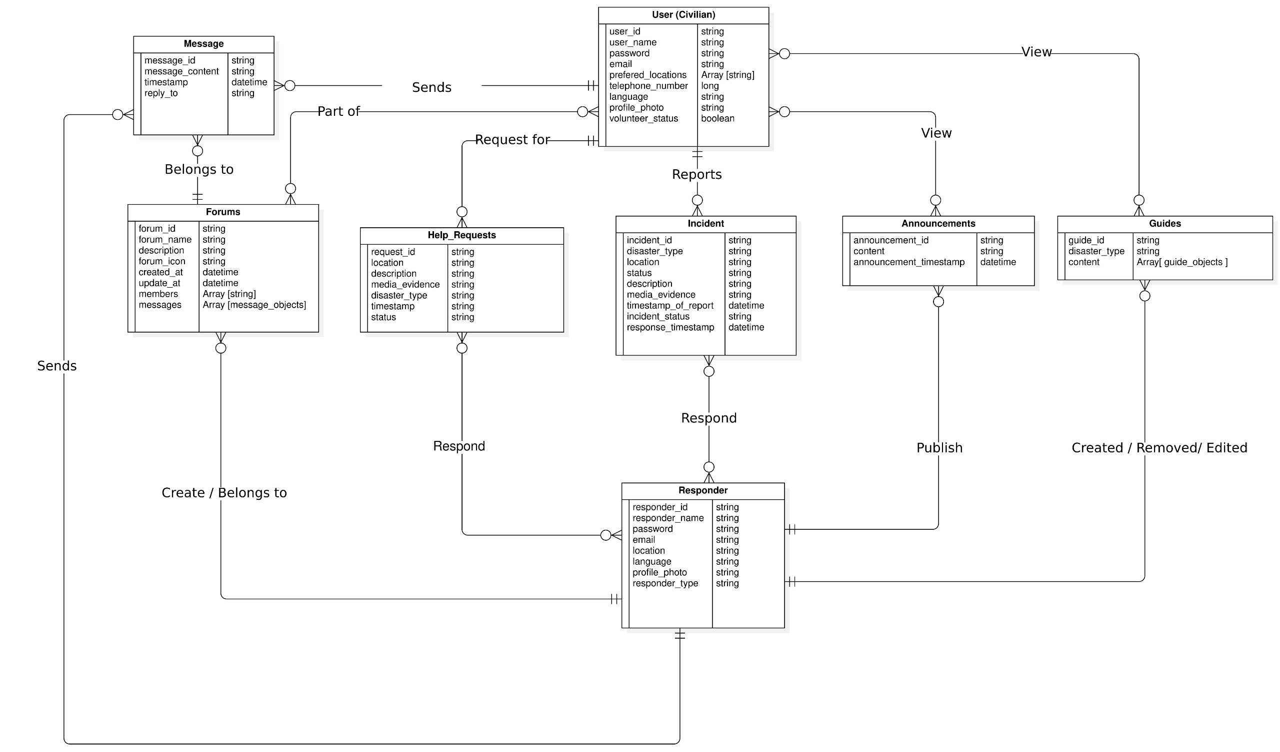

Slide 8
II. Define Relationships and References
The following methods were adopted to create a schema with optimal performance
Optimization structure for reading of frequently read data
Denormalized
Index
Optimization structure for writing of frequently written data
Normalized

Slide 9
II. Define Relationships and References
In cases where the data neither showed a frequent read or frequent write, the following was adopted
One-to-one Relationships
One-to-many Relationships
Many-to-many Relationships
Data size and growth

Slide 10
Example: User and Forums collection
1) User (Civilian)
user_id
user_name
Email
Password
Telephone
Language
profile_photo
volunteer_status
prefered_locations
forums
5) Forums
ID
Name
Description
CreatedAt
UpdatedAt
Author
Members
ID
Member name
Role
Messages (sub-collection)
Id
content:
Timestamp
sender
sender_id:
sender_name
reply_to

Slide 11
3. Database Implementation
Select DBMS and why it was chosen
Firebase project setup and Implementation
Create collections
Implement CRUD operations
Data Validation

Slide 12

I. Select DBMS and why it was chosen
Why Firebase?
Authentication
Fast Development
Scalability
Realtime Capabilities
Offline Functionality

Slide 13
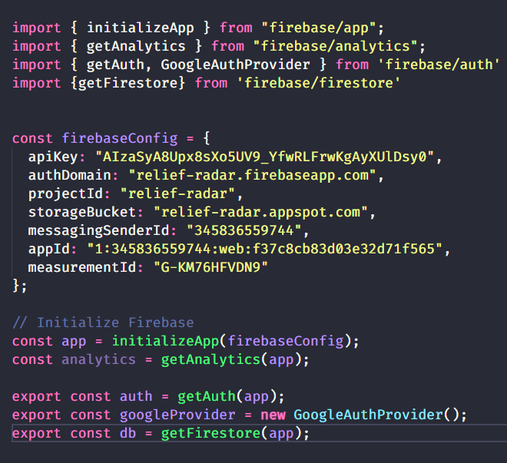
II. Firebase project setup and Implementation
Using Firebase Configuration File
Enable Authentication Providers

Slide 14
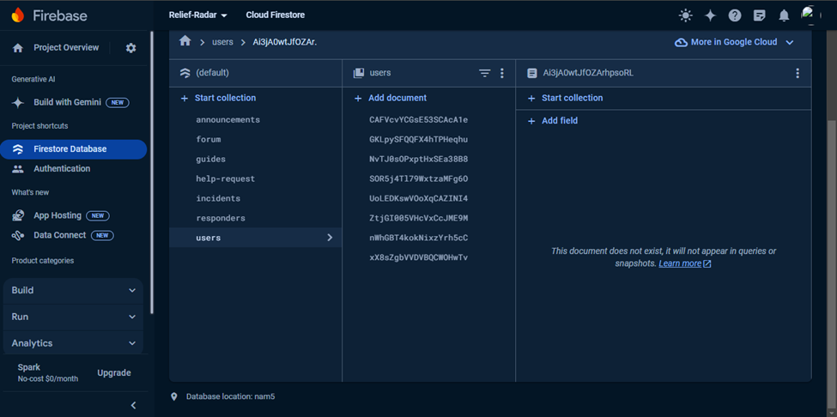
III. Create collections

Slide 15
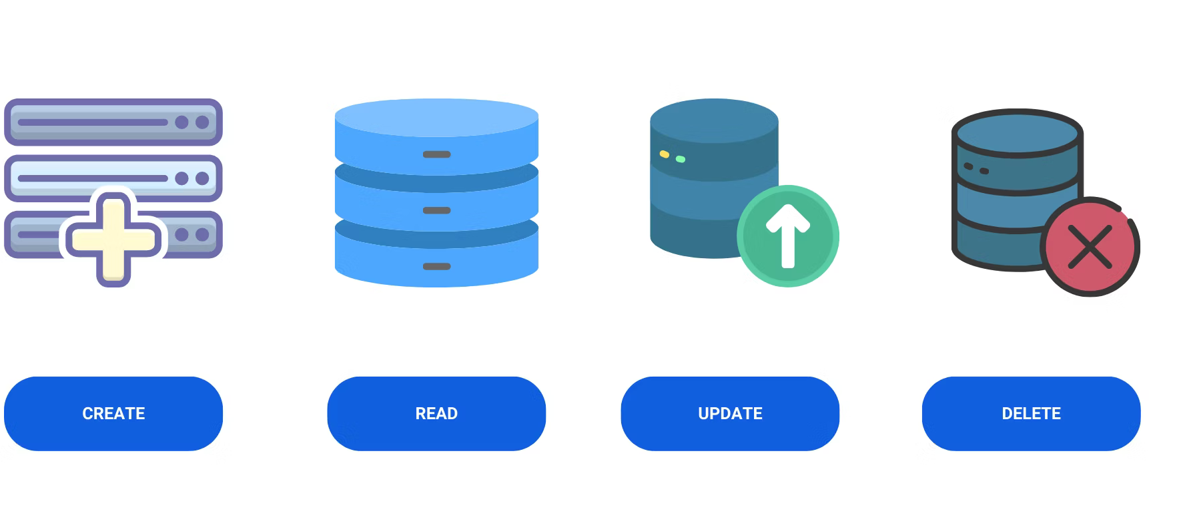
IV. Implement CRUD operations

Slide 16
IV. Implement CRUD operations
Adding documents
Users collection
Incidents collection
Guides collection
CRUD operations

Slide 17
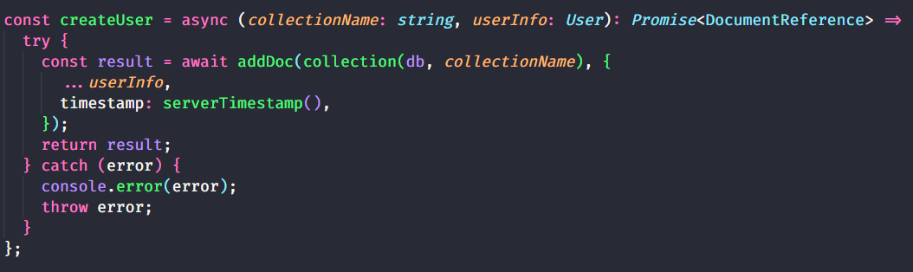
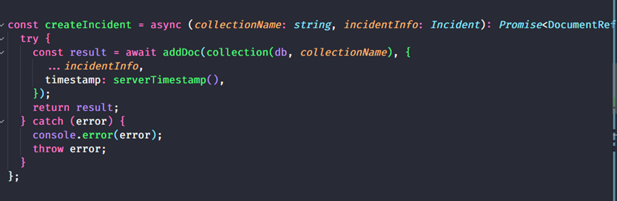
Create

Slide 18
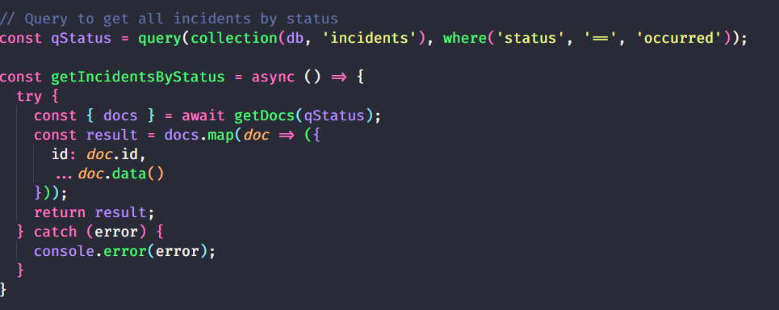
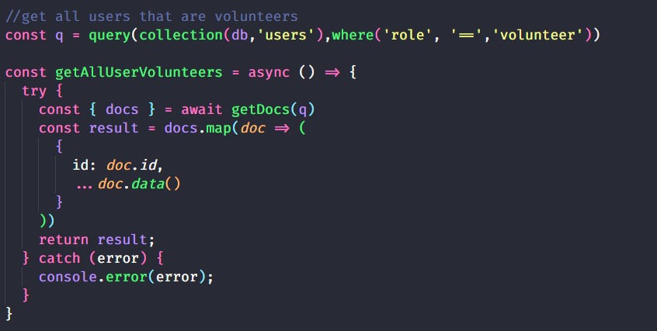
Read

Slide 19
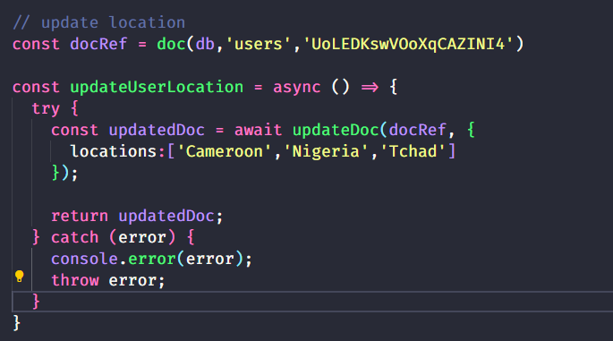
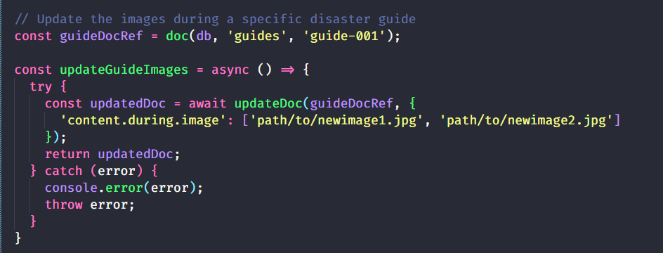
Update

Slide 20
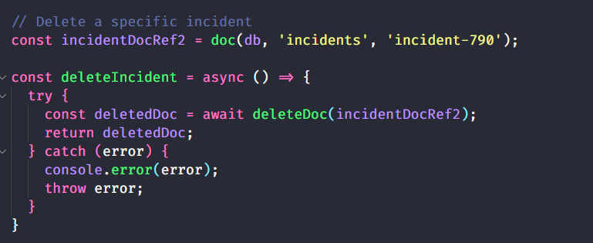
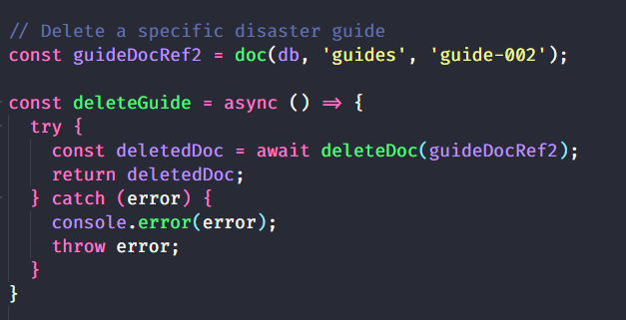
Delete

Slide 21

V. Data Validation

Slide 22
V. Data Validation
Data Type Validation
Required Fields
Pattern Matching
Integration with CRUD Operations
Create
Read
Update
Delete

Slide 23

4. Database Security
Data Protection and Privacy
Encryption
Access Control

Slide 24
THE END!!!

